Slide 1

Building a High-Volume Reporting System on Amazon AWS with MySQL, Tungsten, and Vertica
Gamified Rewards
Notes:
Thanks for coming! I'll try to make this quick so we can all grab the last part of the “backing up FB” session.
About me – Hi, I’m Jeff Malek
This is my second startup, and before that, 14 years ago, I did everything possible to avoid a real, normal job, wandering like a vagabond. So startup junkie, or real-world flunkie - take your pick.
I’m CTO, co-founder at BigDoor.
About BigDoor and why it fits for this talk
BigDoor has been around for almost three years. We help sites create their own branded, gamified rewards programs. Think of it as your own engaging frequent flyer program.
That means we give points to users. Lots of them, with all kinds of different flavors, attributes, types, and conversion rates.
Between customers like Major League Baseball, Island Def Jam recording artists like Big K.R.I.T, another big national sports organization that I can’t mention but that you all know, and the rest of our customers, we accrue a lot of points for users.
We store those and other event-like data in ledger tables, in MySQL. The tables just keep growing, and largely need to, to support business logic and associated API endpoints.
For example, transaction histories need to be returned for users.
We need to be able to report on this data, merging it with web log data, both for canned reports and on an ad-hoc basis.
AWS ; at my last startup all of our systems were on co-located hardware that we managed and maintained, all of BigDoor's systems are in AWS.
I’d like to hear from you what you think when you hear ‘high-volume’.
TODO : For this talk, 10K inserts/updates per second should suffice, which on our system creates x volume per hour...

Slide 2

What I’ll cover:
Our reporting/analytics growth stages,
their pitfalls and what we’ve learned:
Custom MySQL ETL via shell scripts, visualizations in Tableau
ETL via a custom Tungsten applier into Vertica
New Tungsten Vertica applier, built by Continuent
Sharded transactional system, multiple Tungsten Vertica appliers
Notes:
What I’m going to cover
Custom MySQL ETL via shell scripts, visualizations in Tableau
Note that this was something I knew wouldn’t scale, longer term.
ETL via a custom Tungsten applier into Vertica
New Tungsten Vertica applier, built by Continuent
Sharded transactional system, multiple Tungsten Vertica appliers
But first, is there anything that folks came hoping to hear specifically, given the topic? If so I’ll maybe I can try to hit those.

Slide 3
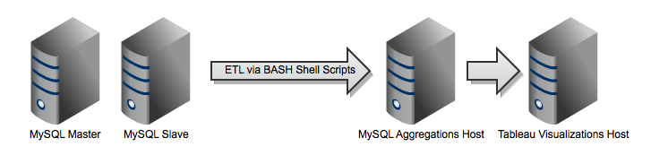
Stage 1 : Custom MySQL ETL via shell scripts, visualizations in Tableau
On slave, dump an hour’s worth of new rows via SELECT INTO OUTFILE
Ship data file to aggregations host, dump old hourly snapshot, load new
Perform aggregation queries against temporary snapshot and FEDERATED tables
Tableau refreshes its extracts after aggregated rows are inserted.
Notes:
Goals for this stage:
Gather data for, and present aggregated reports about the points, levels and badges people were earning through our systems.
What we did
Go over four steps
Gotchas:
Queries against slaves can slow replication.
ETL scripts may be fun and interesting for the author but maybe not so much for maintainers.
Why move from this stage?
I knew from the beginning that this wasn’t going to be the longer term solution, can’t scale.
Didn’t want anyone in the company maintaining the scripted ETL process.
Longer term, wanted a place where we could do ad-hoc queries without affecting transactional layer performance and replication.
This legacy system is still running, at end-of-life.
Primary is M2.4xlarge, with software RAID, 4 EBS volumes, 16kb chunk size
TODO : M2.4xlarge is equivalent of :
TODO : add reporting screenshot

Slide 4
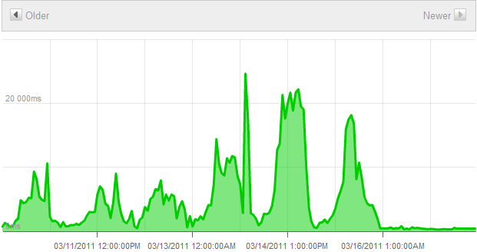
Detour : RAID for the Win
Big drop in
API endpoint latency
(writes)
Notes:
EBS volumes : 100-150 IOPs are standard, but we see spikes much higher than that.
After RAID, seeing spikes over 1K tps during slow times.
RAID makes taking snapshots a bit more complicated. There’s a pretty well-defined process for single volumes.
When doing performance benchmarks, beware : high variability (low consistency) when it comes to EBS write performance. We rolled back our first attempt because of this.
In general, RAID is the best thing you can do for performance on AWS, since writes in particular suck.
At least, now…they’re working on various fronts to improve this.

Slide 5
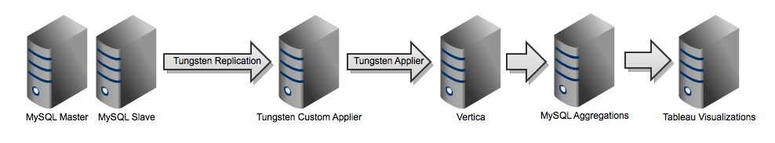
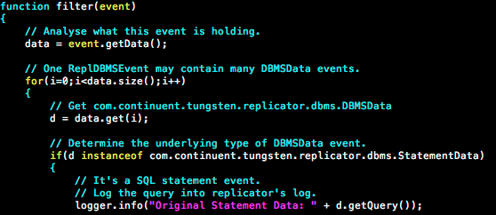
Stage 2 : ETL via a custom Tungsten applier into Vertica
Notes:
Goals for this stage :
Start using a more mature data warehouse platform, needs:
High-volume writes
Performs OK for ad-hoc queries
OK to store de-normalized fact tables and aggregations
Mostly SQL-compliant (vs. MDX, for example)
Support for scale-out, e.g. clustering
MySQL is a great DBMS for OLTP; not so much for answering BI questions
Remove the dependency on custom ETL with a tool that doesn’t affect replication or otherwise screw up the transactional layer
Replace it with a tool that allows for replication of all data if we like, and an easy means to filter out whatever we don’t want.
What we did:
Signed up with Full360 to implement Vertica
Full360 takes care of provisioning the instance, has management scripts for things like backups, and handles the onerous licensing issues that come with Vertica
Vertica takes writes at high volume very well, and is fast to return answers.
Not web-fast, but fast enough for background processing.
Started testing Continuent’s Tungsten replication product
Our DBA wrote a custom filter to forward data to Vertica
Connects via JDBC to Vertica, writing changes on a per-row basis.
Using row-based MySQL replication.
Gotchas
Vertica costs go up with data volume.
Vertica doesn’t accept single-row writes very quickly (but batch writes are very fast).
Why we had to move from this on to the next stage:
We had a few large publishers start using our API, including a large sports organization I’m sure you’re familiar with - MLB
The custom in-house applier that we wrote couldn’t keep up with the volume of writes.

Slide 6
Stage 2 : Customized Tungsten Replication Setup
Master Replicator
Extract binlog to Tungsten Log
MySQL
Extract From
Master to Log
Extract from Log
Filter
Custom Vertica JDBC Applier
Slave Replicator
Filter DDL &
unwanted
tables
Vertica

Slide 7
Stage 2 : Issues with the Custom Tungsten Filter
OLTP transactions on Vertica are very slow! (10 transactions per second vs. around 1000 per second for a MySQL slave). Slave applier could not keep up with MySQL master.
Person who created the applier was no longer in the company.
Tungsten setup including custom applier was difficult to maintain and hard to move to other hosts.

Slide 8
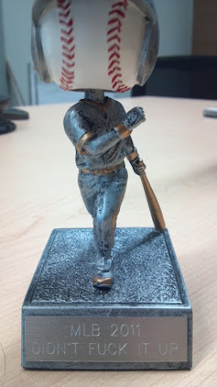
Detour : flexible APIs and baseball schedules
Notes:
(for those of you who can't read this)
If so-and-so hit a single, every single user would get a badge, at the same time.
I’m sure you can imagine how that raised some eyebrows on our side of things, in contrast to normal web traffic – this was ‘spike’ defined.
We all started paying heavy attention to the game schedules.
We were able to handle the load well, but it’s an example for how having an API can bring surprises.
They're continuing to use us this year.

Slide 9
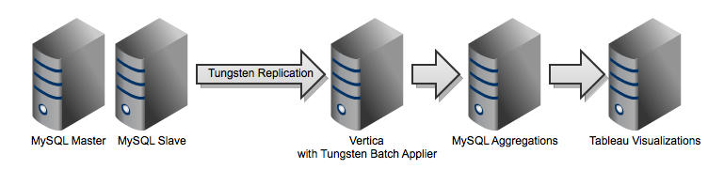
Stage 3 : New Tungsten Vertica Applier
Notes:
Goals for this stage:
Keep up with the rate of inserts and updates from the transactional system, applying changes directly to Vertica in near-real-time.
As I mentioned, our custom applier wasn’t keeping up. So we called Continuent.
They’d wanted to build an applier for Vertica for some time, anyway.
To my knowledge, this hasn’t been done.
Things that help when you’re working with a third party like this:
Highly normalized schema
Keep the data-types simple
Low rate of change to schema. We had this because the API was designed to be very flexible right out of the gate.
Gotchas :
Time-zones – Robert, do you want to touch on that a bit?
Source data stored in UTC
Transforms should be done at presentation layer, ideally.
Character sets
Use UTF-8 across the board
Why we had to move on from this stage:
Another large publisher with a huge audience, also a large sports organization, loomed on the horizon
We needed to scale our systems 20x to handle their traffic.
So we sharded our transactional layer.

Slide 10
Stage 3: A Template-Driven Batch Apply Process
Tungsten Replicator Pipeline
Extract-
Filter-
Apply
Extract-
Filter-
Apply
Extract-Filter-Apply
MySQL
Base Tables
63, ‘bob’, 23, …
64, ‘sue’, 76, …
67, ‘jim’, 1, …
76, ‘dan’, 25, …
98, ‘joe’, 66, …
Staging Table
233, d, 64, …, 1
233, i, 64, …, 2
239, I, 76, …, 3
CSV
Files
COPY
(Template)
DELETE, then INSERT
(Template)

Slide 11
Stage 3 : Batch Applier Replication Setup
Master Replicator
Extract binlog to Tungsten Log
MySQL
Extract From
Master to Log
Extract from Log
Filter
Batch applier using SQL template commands
COPY / INSERT
Slave Replicator
CSV
Use built-in
Filters; DDL ignored
Vertica
Write date to
disk files

Slide 12
Stage 3 : Solving Problems to Get the New Applier to Work
Testing – Developed a lightweight testing mechanism for heterogeneous replication
Batch applier implementation – Two tries to get it right including SQL templates and full datatype support
Character sets – Ensuring consistent UTF-8 handling throughout the replication change, including CSV files
Time zones – Ensuring Java VM handled time values correctly
Performance – Tweak SQL templates to get 50x boost over old applier

Slide 13
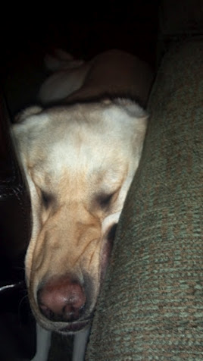
Detour : Sharding or Learning How To Sleep In Any Position
Notes:
Six weeks of no sleep
Didn’t port ledger data, just configuration data.
Thank you team!

Slide 14
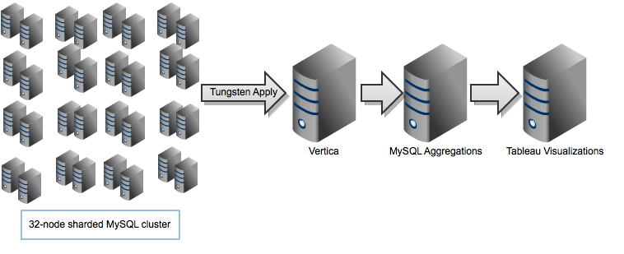
Stage 4 : Sharded transactional system, multiple Tungsten Vertica appliers
Notes:
Goals for this stage:
Change the Vertica applier so that it can be run from a MySQL slave, doing remote batch apply to Vertica
Run 16 appliers from a sharded MySQL cluster into Vertica
Maintain a backlog of data for ad-hoc queries, otherwise cull and archive older data to keep the Vertica data set small
Still in beta test, but looking promising.

Slide 15
Solving Problems to Scale Up The Replication Configuration
Implement remote batch apply so Tungsten can run off-board from Vertica
Convert replication to a direct pipeline with a single service between MySQL and Vertica
Create a script to deploy replicator in a single command
Create staging tables on Vertica server

Slide 16
Remaining Challenges to Complete Replication Setup
Configure replication for global and local DBShards data
Ensure performance is up to snuff-currently at 500-1000 transactions per second
Introduce intermediate staging servers to reduce number of replication streams into Vertica

Slide 17
Thank You!
In summary:
Tungsten is a great tool when it comes to MySQL ETL automation, so check it out as an alternative to custom in-house scripts or other options.
Vertica is a high-performance, scaleable BI platform that now pairs well with Tungsten. Full360 offers a cloud-based solution.
If you’re just getting started on the BI front, hire a BI developer to focus on this stuff, if you can.
I see no reason why this framework couldn’t scale to easily handle whatever our business needs in the future.
Notes:
In summary:
Tungsten is a great tool when it comes to MySQL ETL automation, so check it out as an alternative to custom in-house scripts or other options.
Vertica is a high-performance, scaleable BI platform that now pairs well with Tungsten. Full360 offers a cloud-based solution.
If you’re just getting started on the BI front, hire a BI developer to focus on this stuff, if you can.
I see no reason why this framework couldn’t scale to easily handle whatever our business needs in the future.

